Slide 1

MICRONEEDLE MOLD USING EDM
Team No. 52
Maroju Sreeram Rohan(200103076)
Mergu Vishwaja(200103077)
Nekkanti Sweshik(200103083)

Slide 2
CONTENTS:
Introduction
Theory
Procedure
Results
Observations

Slide 3
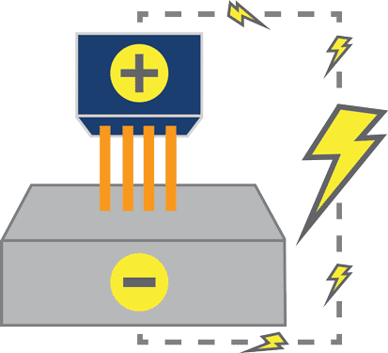
INTRODUCTION:
Manufacturers often turn to electrical discharge machining (EDM) whenever traditional machining methods reach their limit. The EDM process involves using thermal energy to remove excess material from an object, creating the required shape for a task.
EDM is similar to processes such as laser cutting. It does not require or use mechanical force to remove the excess material. This is why many people consider it to be a non-traditional manufacturing process. This process helps in molding and tooling for a wide range of industries.
There are different type of EDM processes. In our project we used wire EDM.

Slide 4
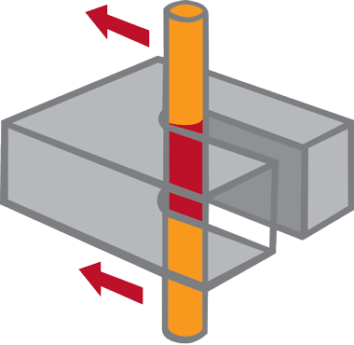
THEORY:
Wire electrical discharge machining (WEDM) uses a metallic wire to cut or shape a workpiece, often a conductive material, with a thin electrode wire that follows a precisely programmed path.
During the wire cutting process there is no direct contact between the wire and the workpiece which allows for machining without causing any distortion in the path of the wire, or the shape of the material.
To accomplish this, the wire is very rapidly charged to a desired voltage. The wire is also surrounded by deionized water.
When the voltage reaches the correct level, a spark jumps the gap and melts a small portion of the work piece. The deionized water cools and flushes away the small particles from the gap.
Wire Cutting

Slide 5
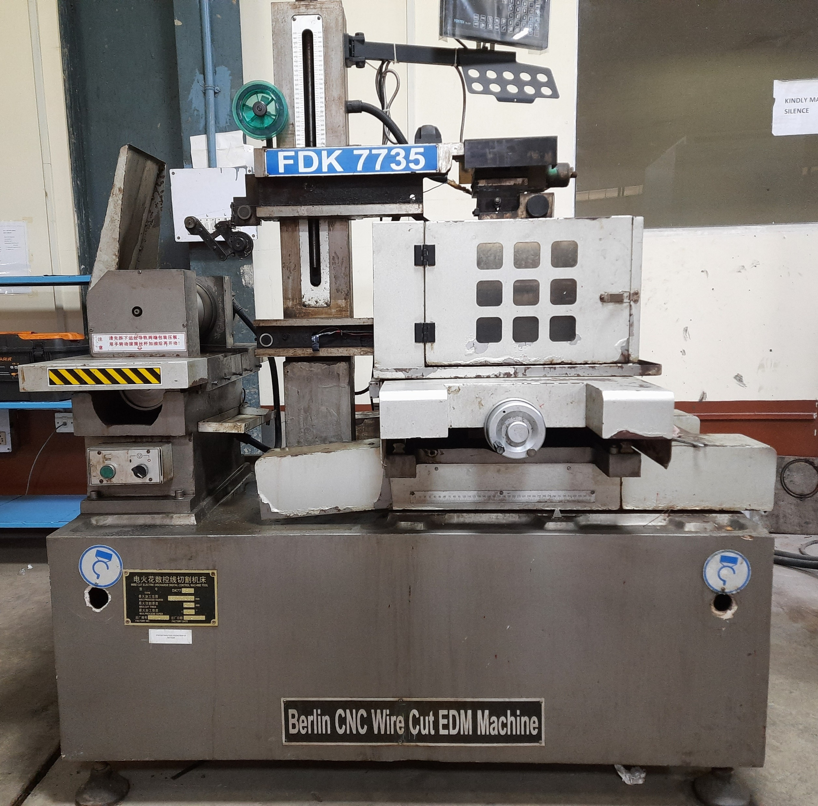
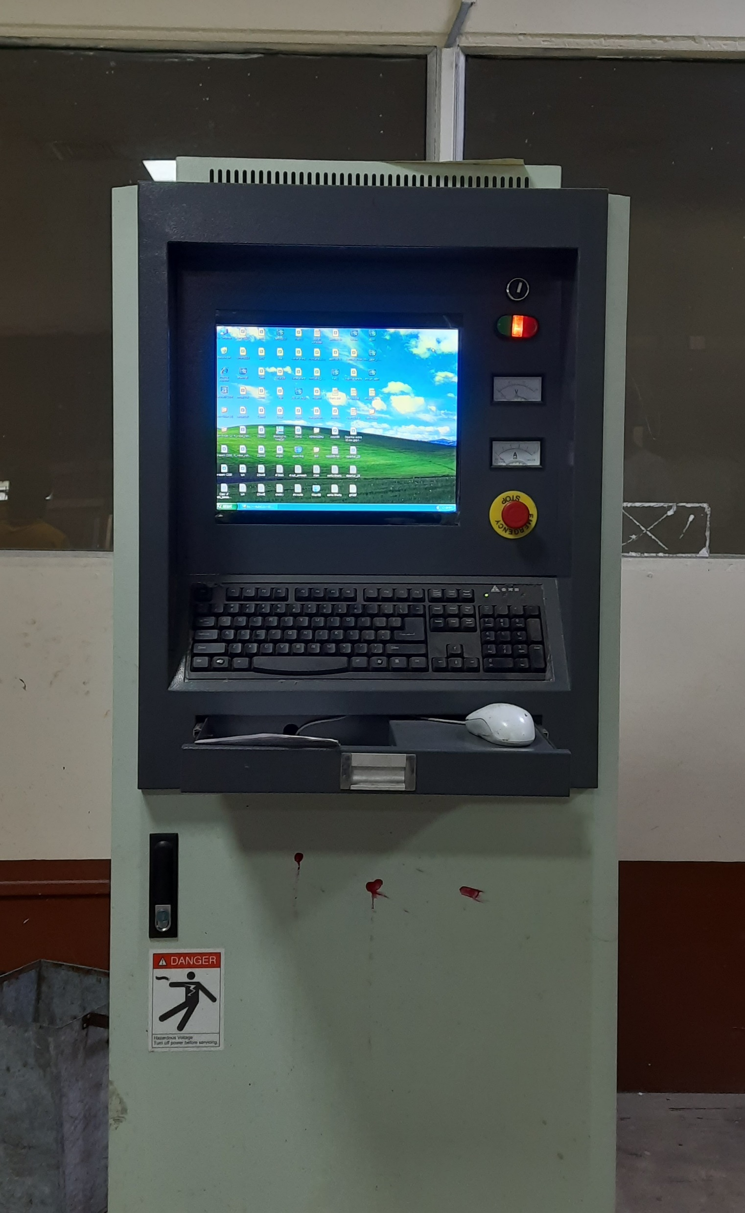
Wire EDM apparatus in Mechanical Workshop, IITG.

Slide 6
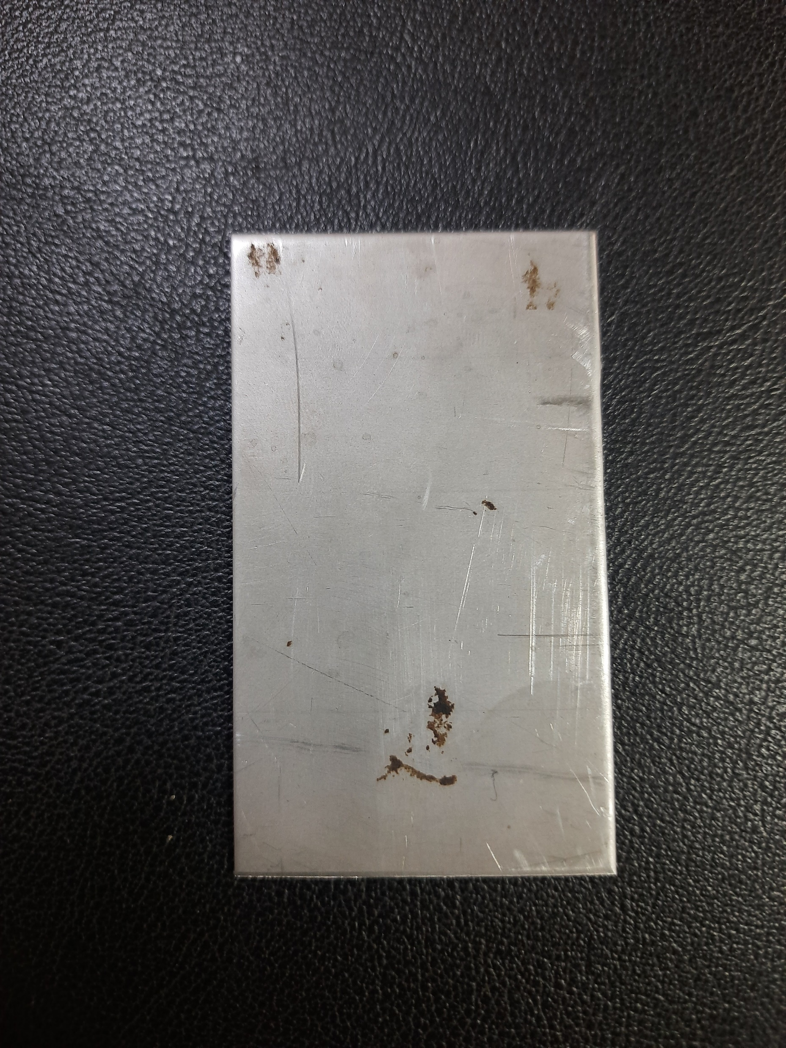
PROCEDURE:
We selected a workpiece of [ 70.3×40.25×1.06 ]mm dimensions and of stainless steel material which is shown below.

Slide 7
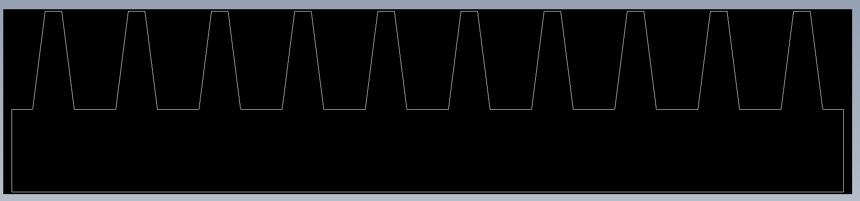
PROCEDURE:
In order to perform the machining one should make a CAD model of the required mold.
The CAD model shows the wire the path to be followed.

Slide 8
PROCEDURE:
After giving input of the CAD model we’ll install the wire.
Next, fix the workpiece to the vice.
Now adjust the machine settings.
Once the EDM machine is setup the cutting process will begin.
The wire is fed through the material and electric current is passed through that material creating sparks that erode the material.
As the machining is done dielectric fluid i.e. water will flow from the top in order to produce smooth finishing and removing of debris.

Slide 9
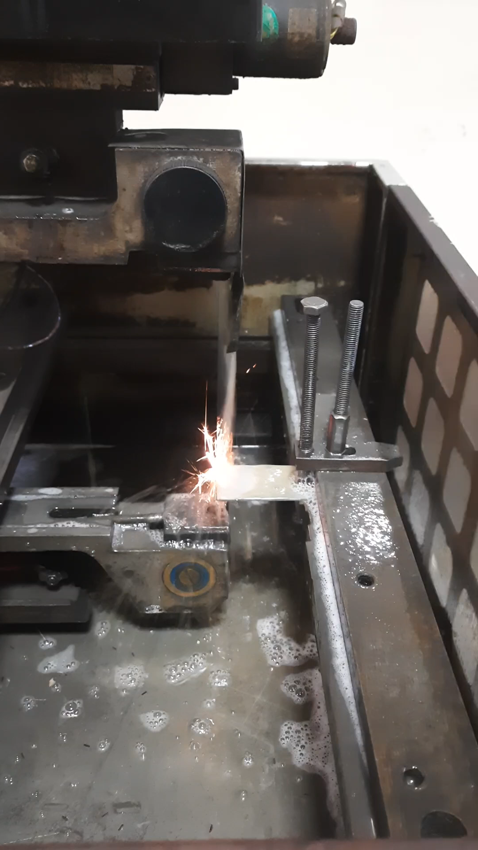
PROCEDURE:
Video of the machining process.

Slide 10
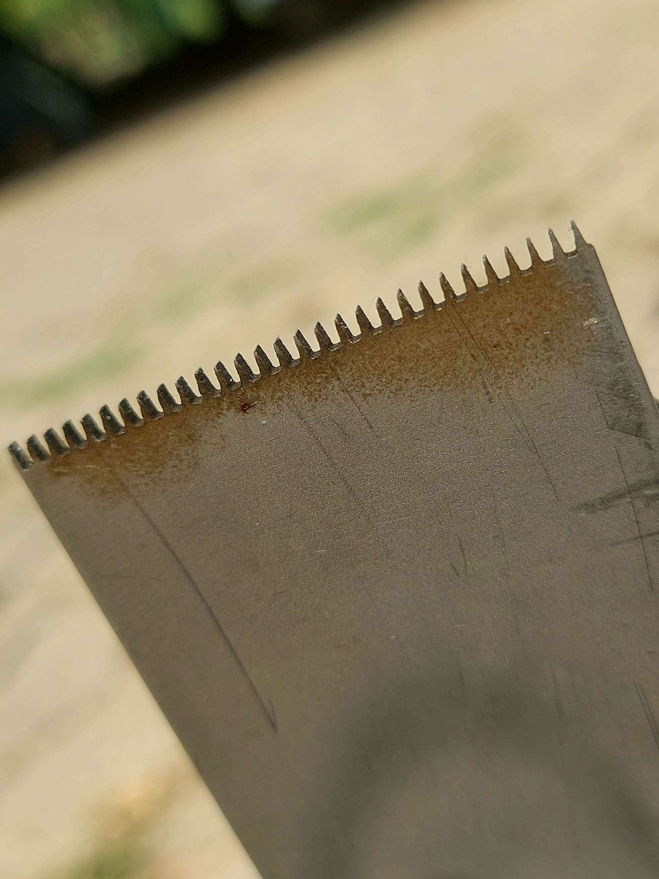
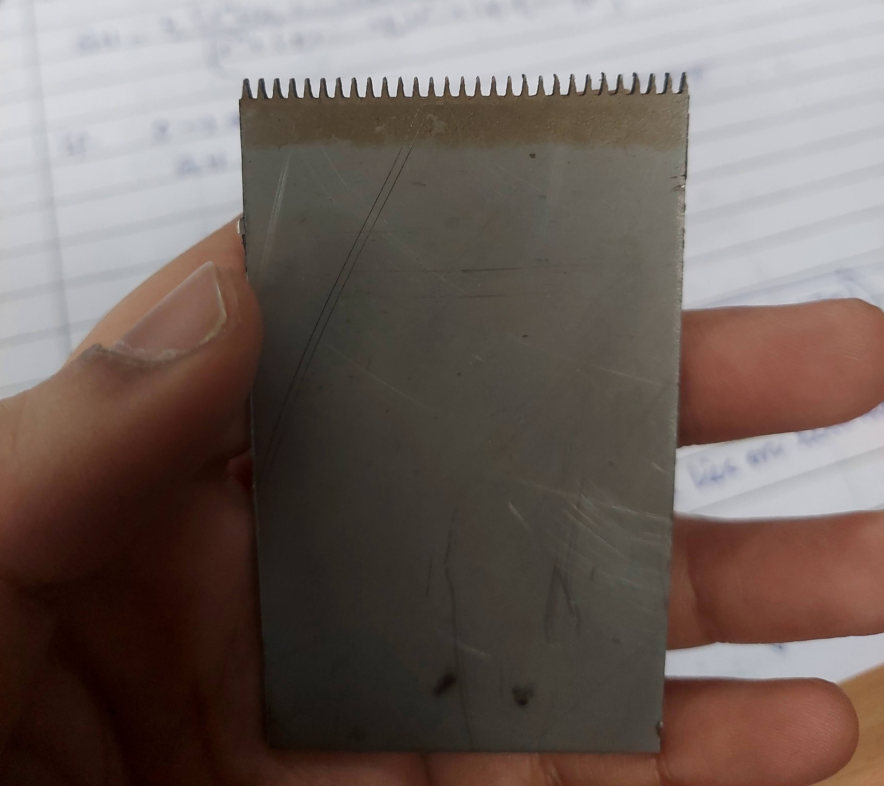
Results:
The obtained product is shown below.

Slide 11
results:
Distance between bottom ends of taper is 0.965 mm.
Distance between top ends of one set of consecutive tapers is 0.161mm and another set of consecutive tapers is 0.217mm.
Distance between bottom right end of one taper and bottom left end of it's right taper is 0.498mm.
Height of the taper is 1.954mm.
Angle made by slant height of taper with vertical is approximately 6.1 degrees.
We used Optomech Vertical Profile Projector to measure the dimensions of the obtained mold.

Slide 12
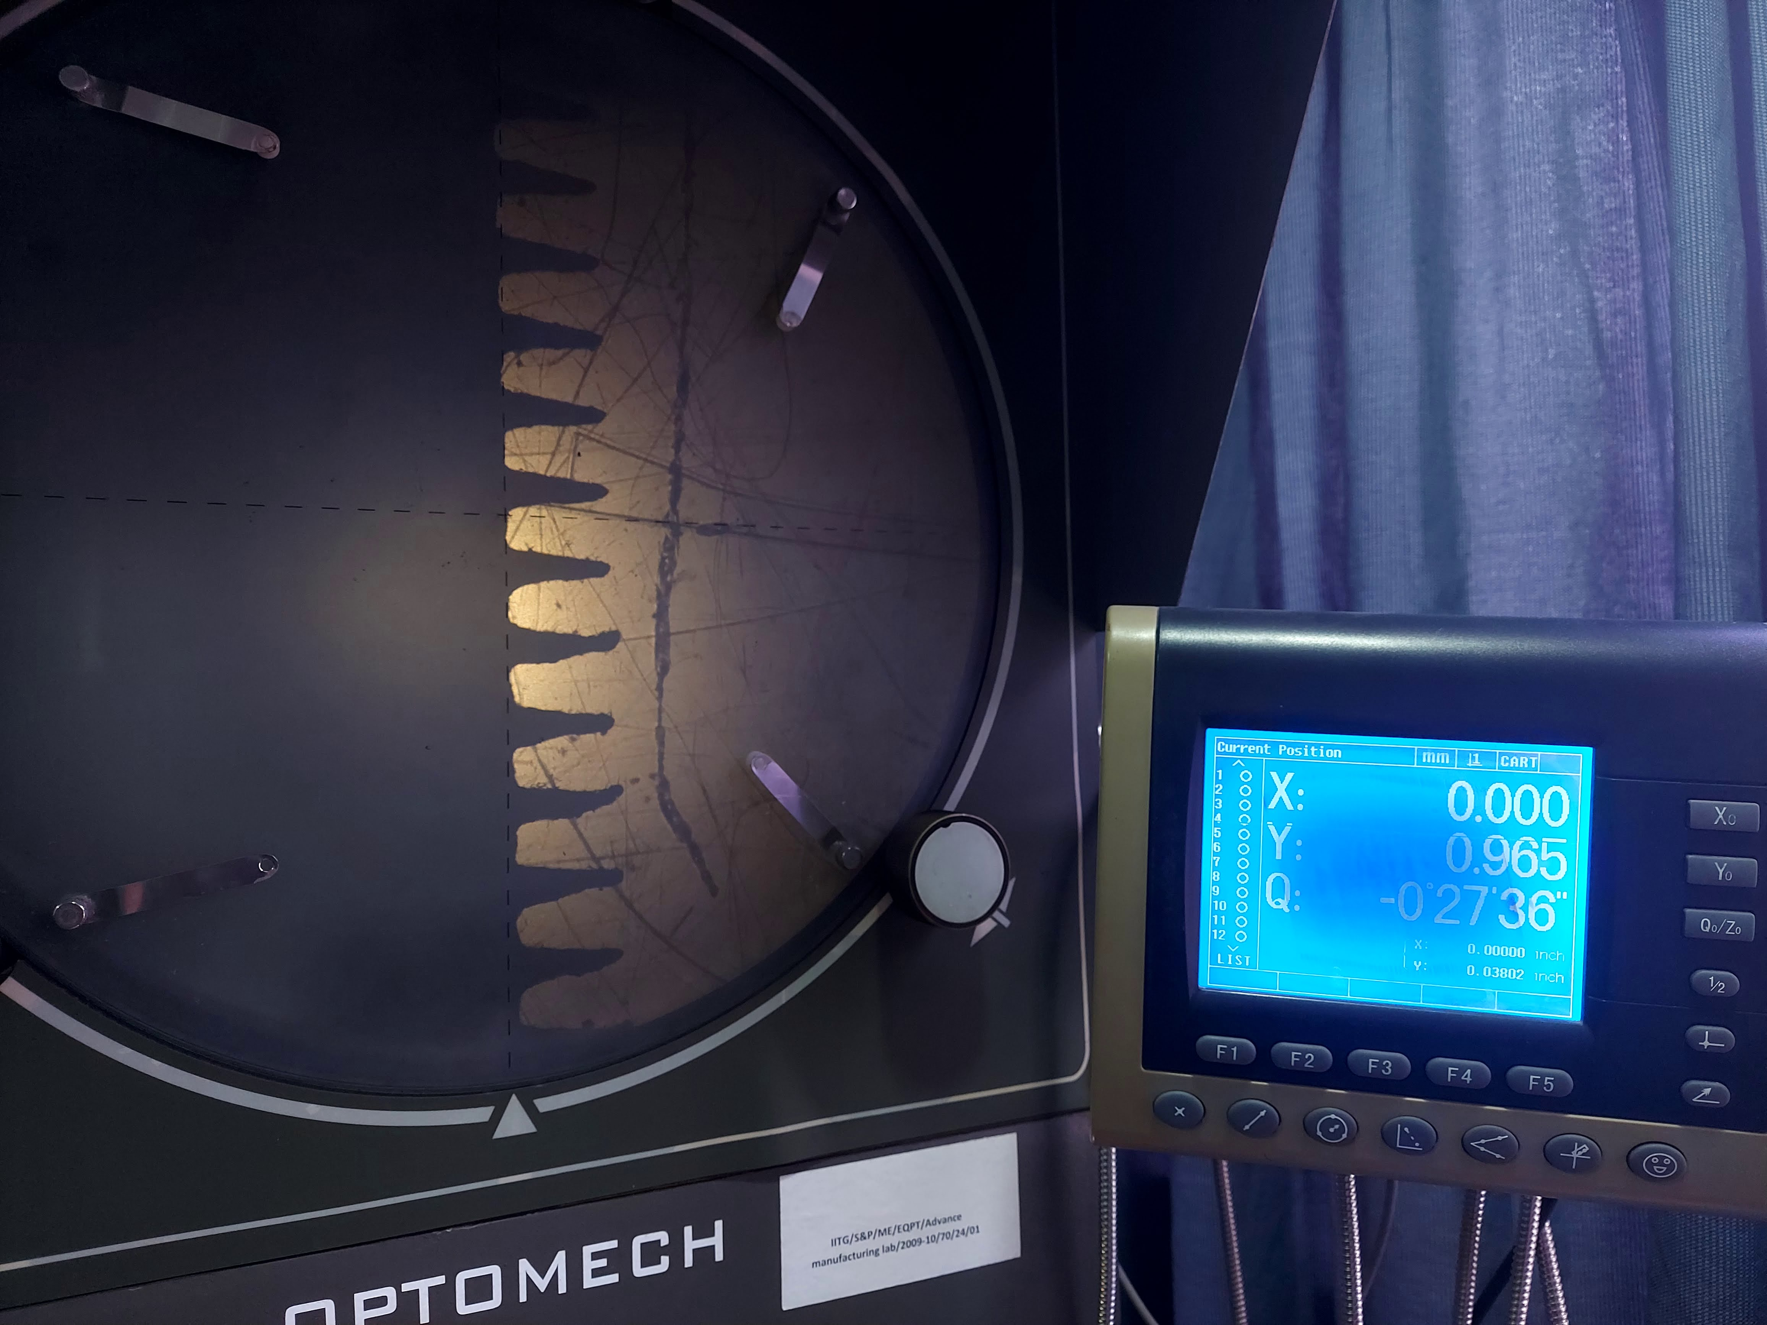
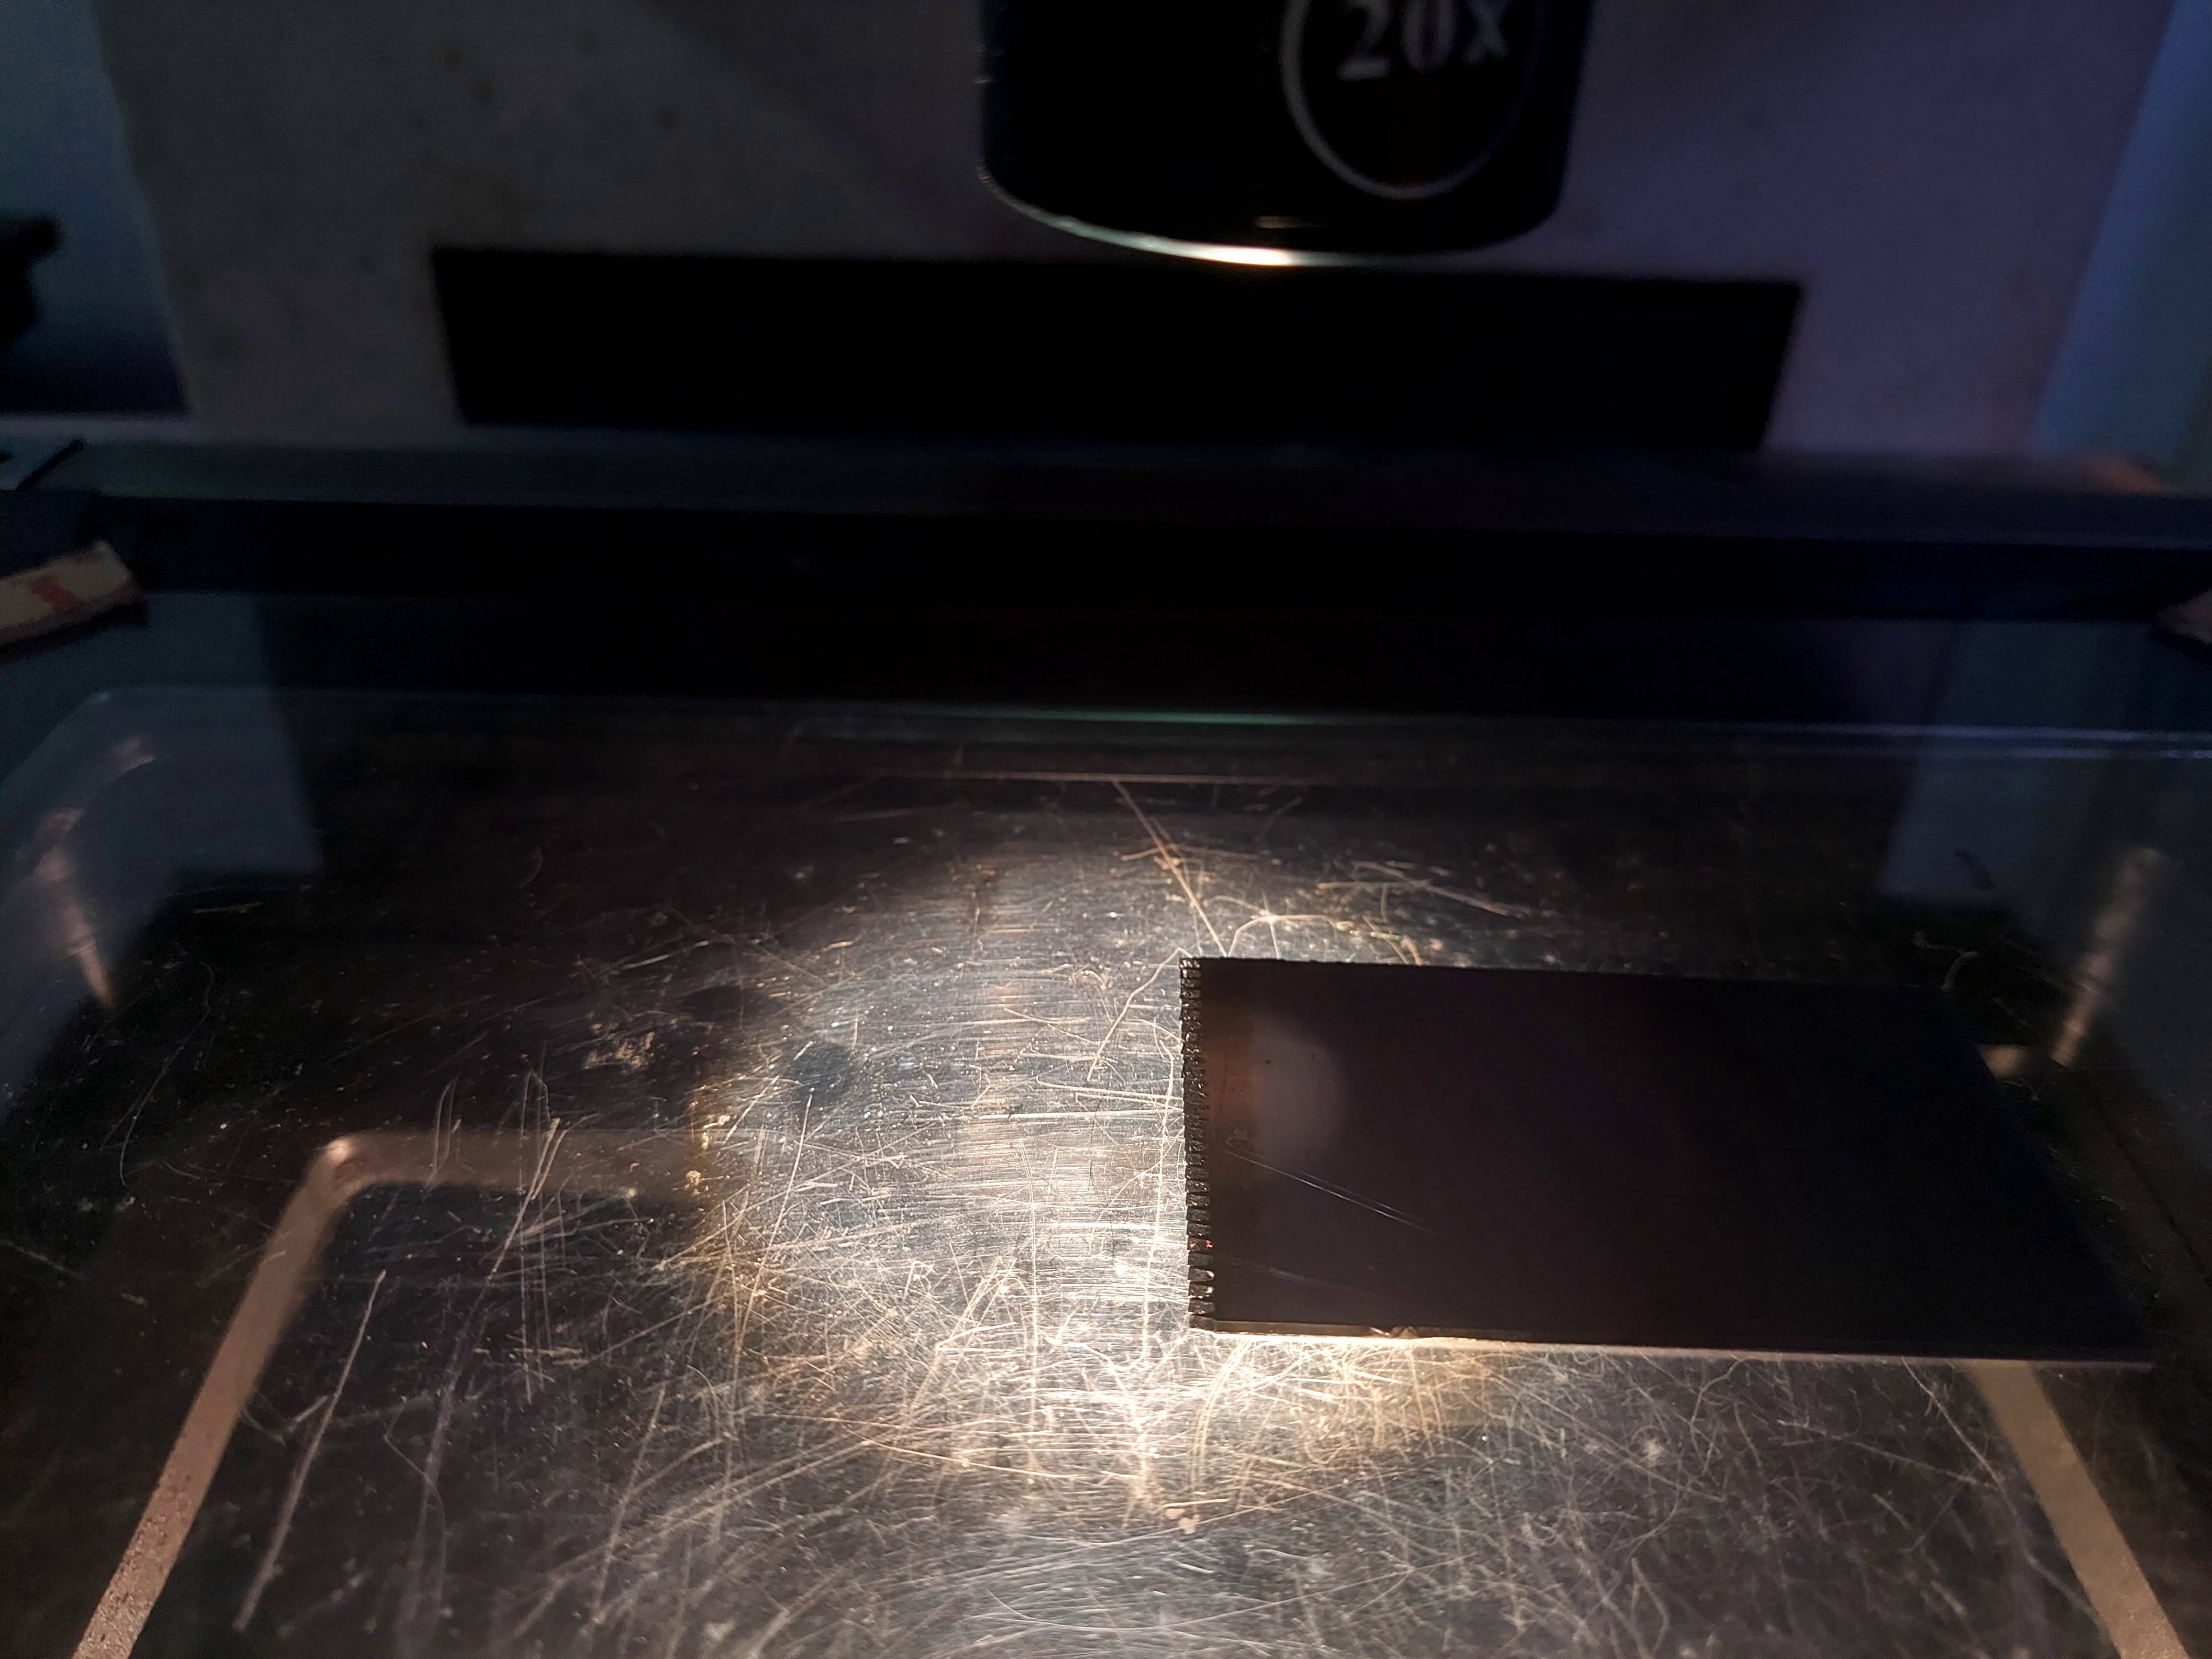
Optomech Vertical Profile Projector in Meteorology lab, IITG.

Slide 13
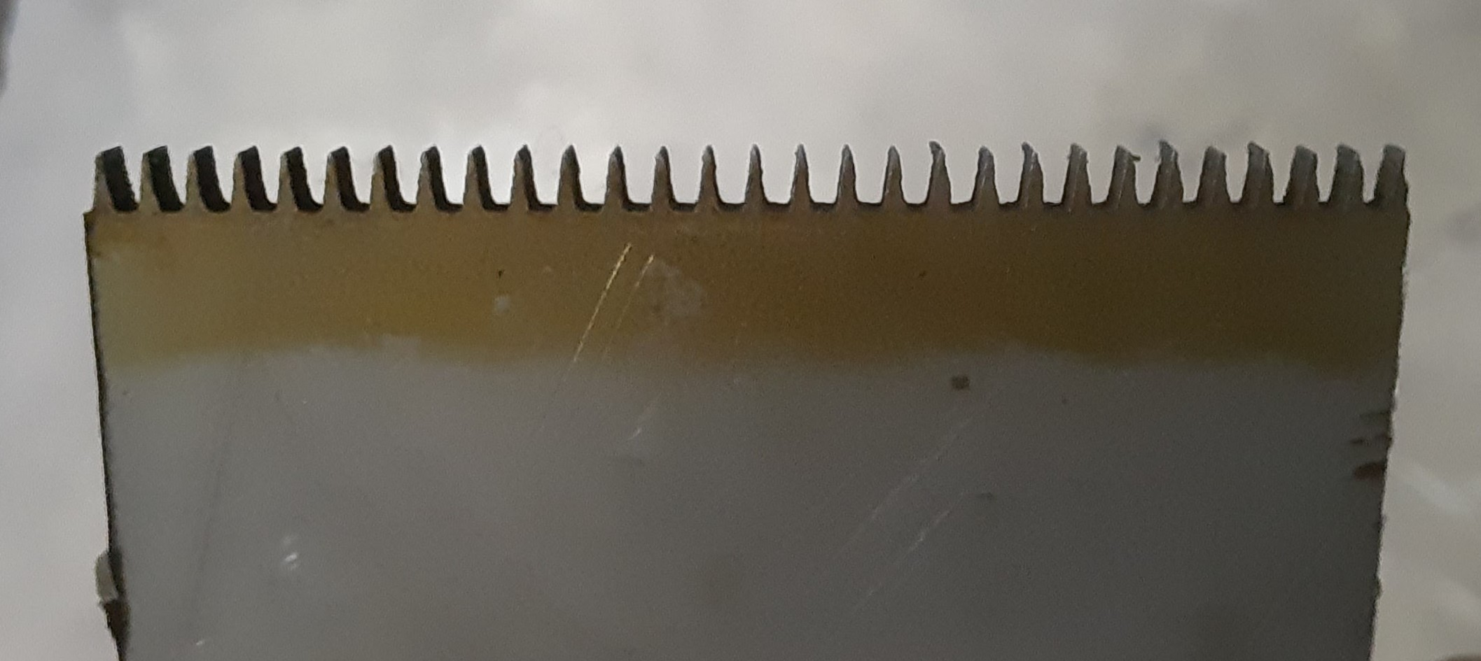
observations:
We can observe that the distances between bottom ends of tapers is nearly same.
Where as the distance between top ends of tapers is not same.
The distance to be travelled by the wire is reduced to some micrometers by which machine loses it's accuracy.
We can also see a golden brown surface occurring near the tapers which is heat affected zone.

Slide 14
Thank you
Thank you

